Slide 1
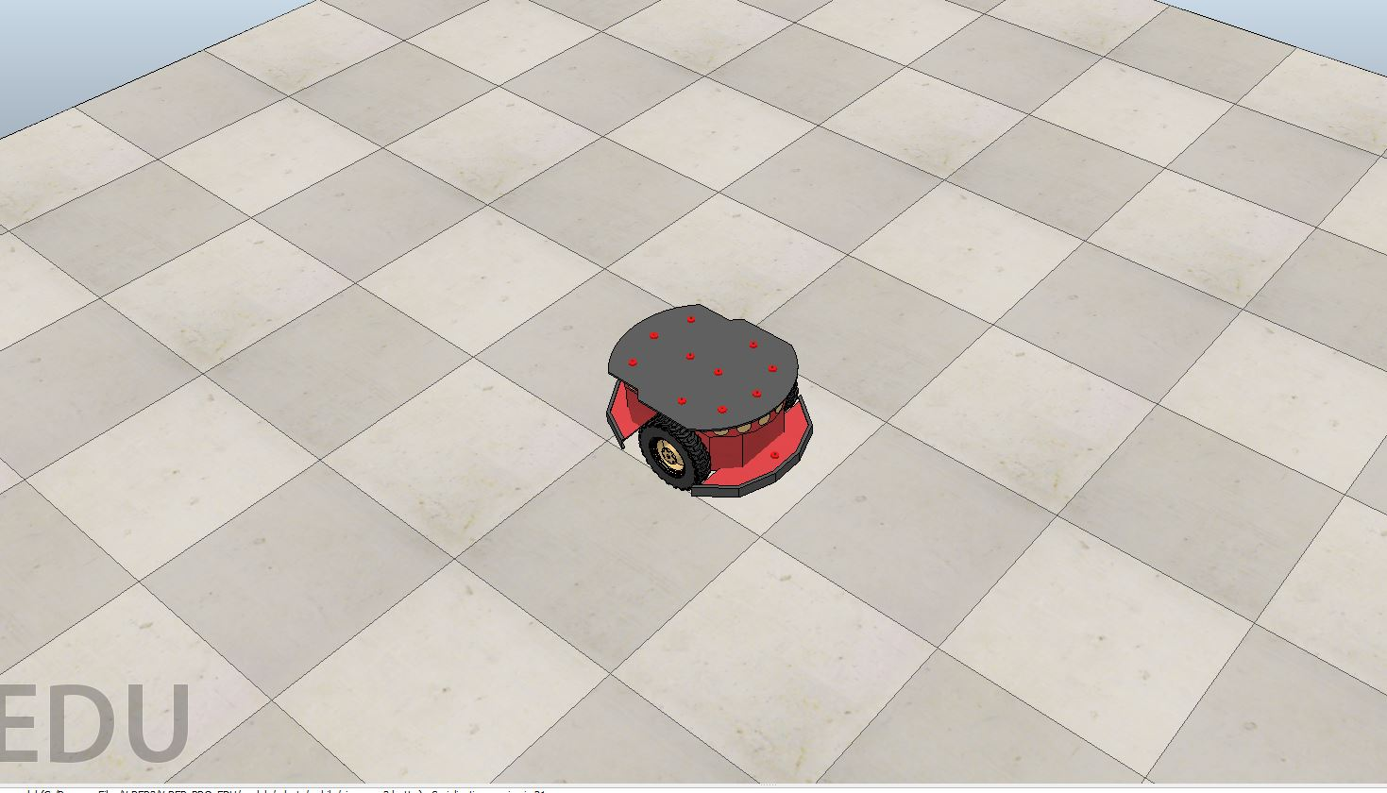
Autonomous Mobile Robot Navigation using Adaptive Neuro Fuzzy Inference System
D-034
Presenter
Muhammad Husnain Haider
Co authors:
Hub Ali, Abdullah Aman Khan, Hao Zheng, M. Usman Maqbool Bhutta, Shaban Usman, Pengpeng Zhi, Zhonglai Wang*
May 27, 2022
2022 International Conference on Innovations and Development of Information Technologies and Robotics (IDITR 2022)

Slide 2
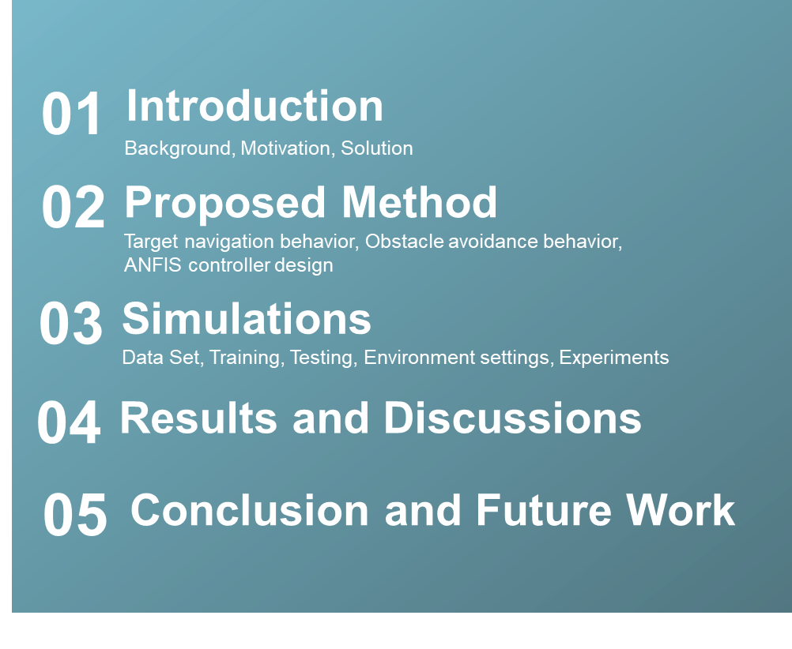
Contents

Slide 3
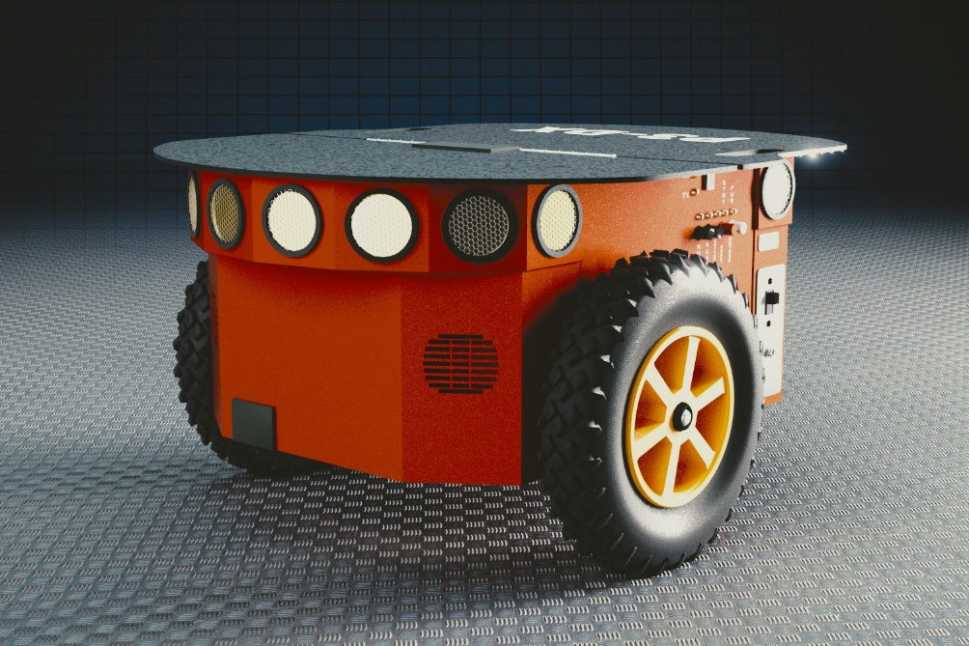
Introduction
Why do we need robots and what tasks can wheeled mobile robots perform autonomously?
Motivation behind choosing ANFIS?
Global navigation Algorithms
Visibility Graphs
Veronoi Graphs
Dijkstra
Applications
Problem
High computational demand for complex environments
No solution for local planning
Real-time navigation
Over the past decades, autonomous robots have played
an essential role in my many areas only a few of them are enlisted below
Industrial Applications
Agriculture
Space Exploration
Solution
Neuro Fuzzy Systems
ANFIS
Fukushima nuclear power
plant

Slide 4
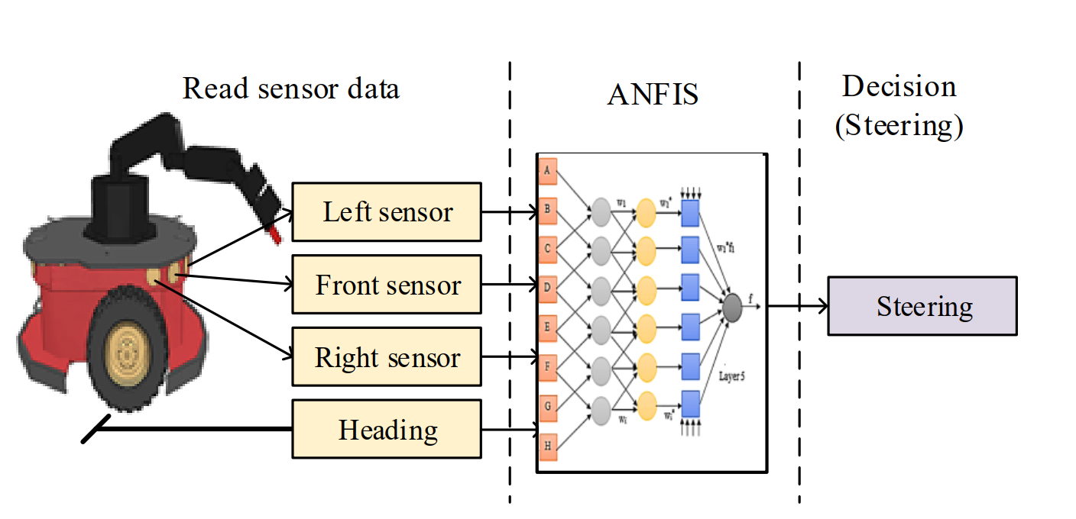
Proposed
Overview
The mobile robot takes the heading angle along with distance sensors readings. ANFIS processes this
information to find the suitable steering angle to achieve the target while averting obstructions under the current scenario.
Method

Slide 5
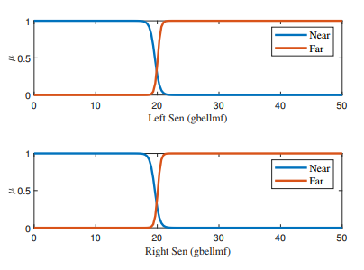
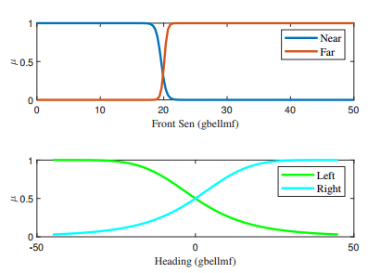
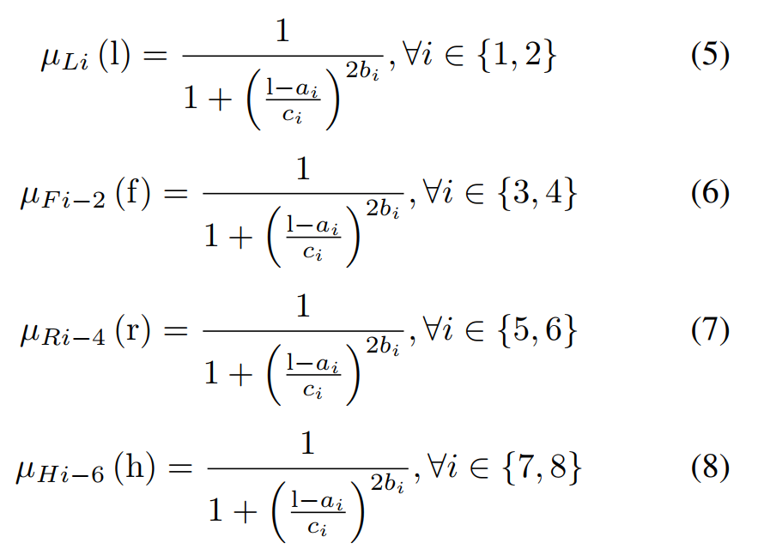
Input Membership Functions
Proposed
Method
The blue and red curves represent the membership functions of near and far linguistic variables, whereas aqua blue and green curves indicate left and right heading directions, respectively.
Where ai, bi, and ci are the premise parameters of the gaussian bell (gbell) membership functions.

Slide 6
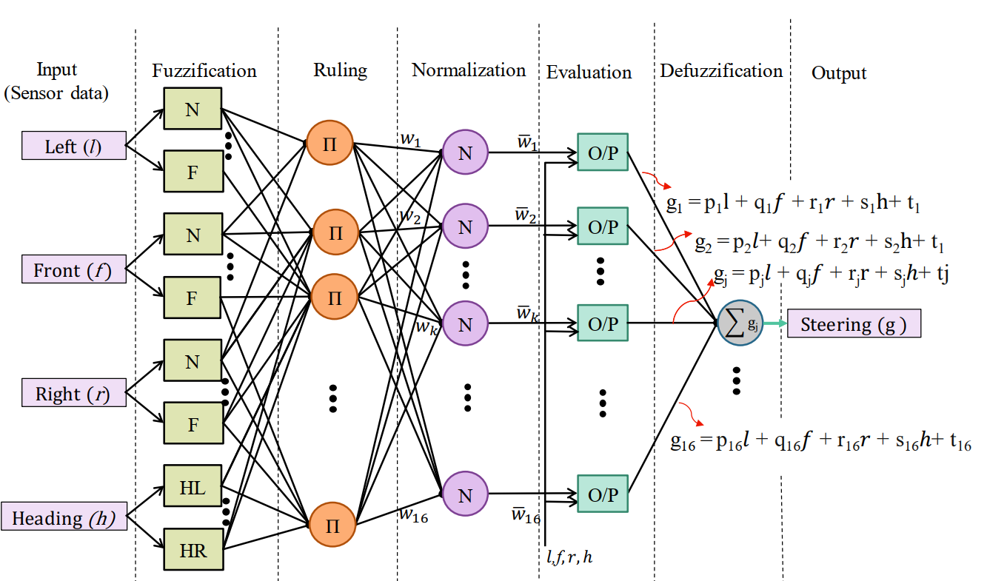
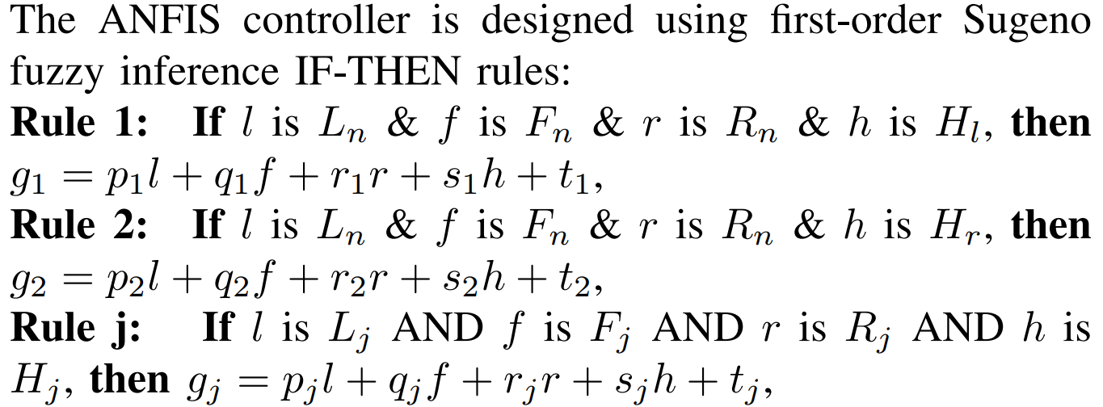
ANFIS controller design
Proposed
Method
Here, N, F, HL, and HR represent near, far, left
heading, and right heading, respectively, while p, q, r, s, t
stand for consequent parameters.

Slide 7
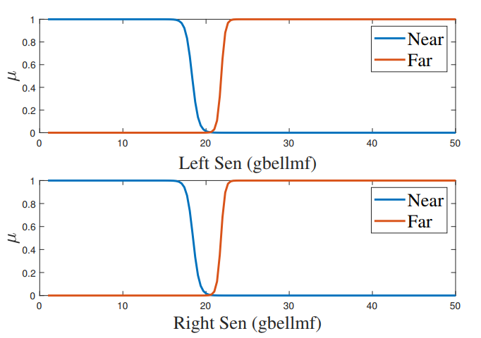
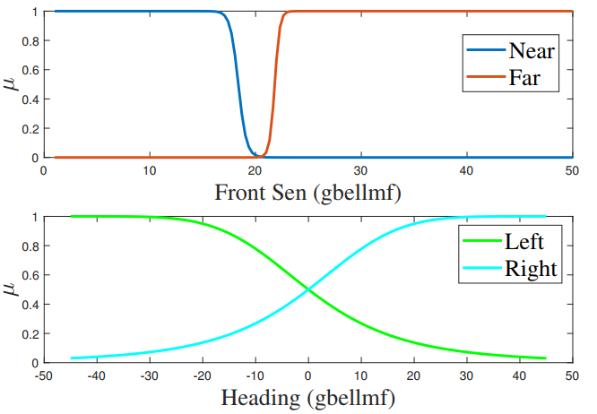
Trained Membership Functions
Simulations
The blue and red curves represent the membership functions of near and far linguistic variables, whereas aqua blue and green curves indicate left and right heading directions, respectively.
(Training)

Slide 8
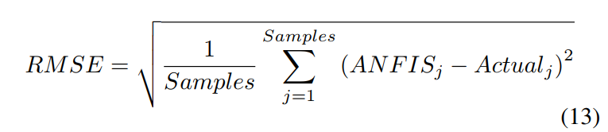
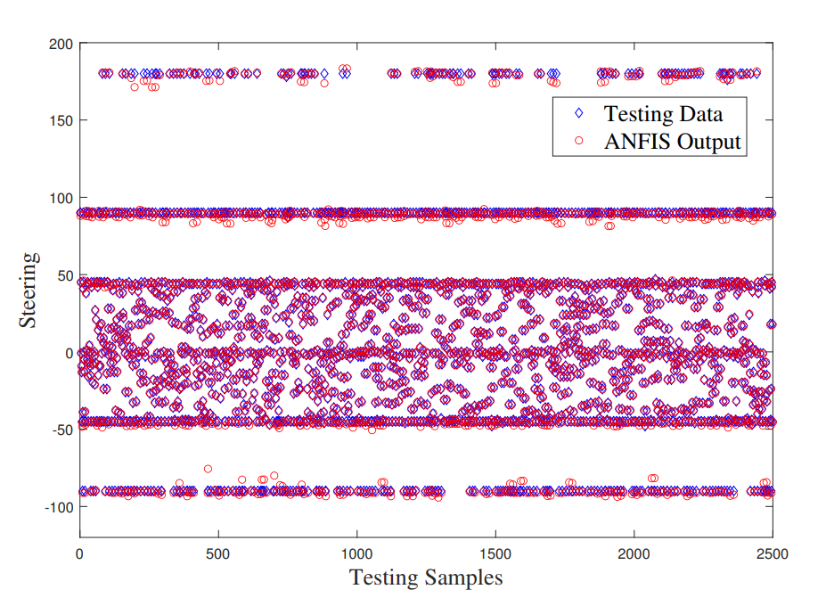
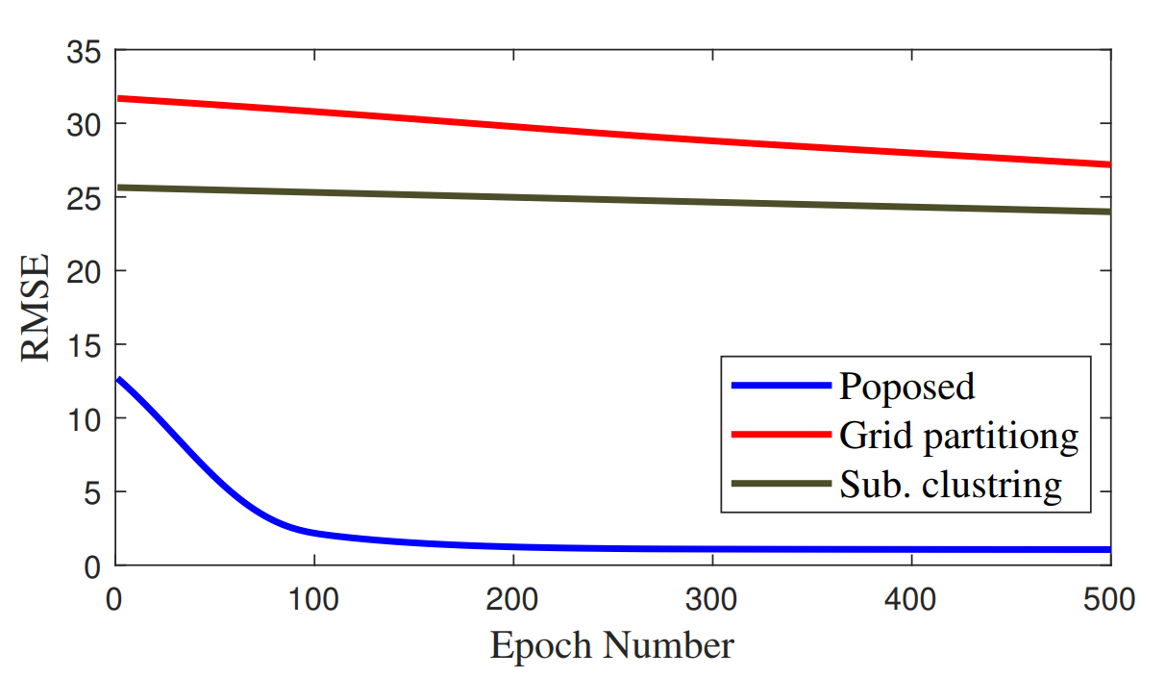
Trained Membership Functions
Simulations
The training errors are computed using the root mean square error (RMSE) function, which is written as:
(Testing)
ANFIS steering output and the testing sample results show coherence in nature. The blue diamond represents the samples for the testing data, and red circles indicate the corresponding ANFIS output (Zoom in for a better view).
Fig 6 provides the visual comparison among the 2500 testing data samples and ANFIS controller outputs for the steering angle.
The average testing error is around 1 degree in the ANFIS after 500 epochs.
RMSE of proposed ANFIS controller, sub. clustering, and grid partition over the same generated data set

Slide 9
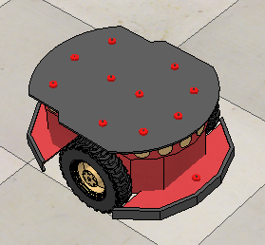
Simulations
API
Platforms and Environment
An API connection is necessary for
both platforms to communicate while performing simulations.
MATLAB
CoppeliaSim
MATLAB 2021a
All the training and testing of FIS are executed in MATLAB
Responsible for mobile control
Mobile robot speed is considered constant during the experiments
CoppeliaSim Edu 4.2.0
A three-wheeled mobile robot ’Pioneer 3dx’ with two front wheels having independent motor control and a roller wheel at the rear is used to perform simulations.
Obstacles prone environment is designed in CoppeliaSim

Slide 10
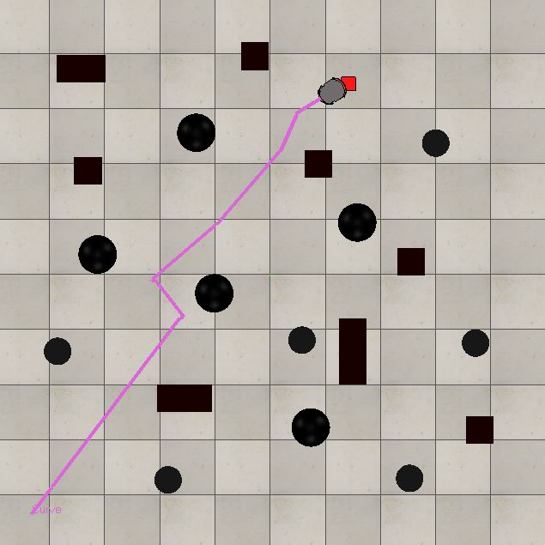
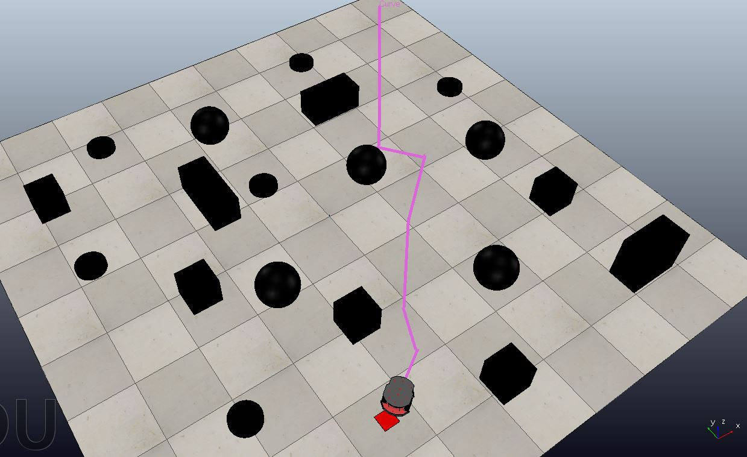
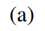
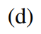
Results and Discussions
Cluttered obstacle prone environments
Selected simulation results
Fig. 7-(a) and
Fig. 7-(d) represents top view and 3D view respectively
From the images, it can be observed that the robot safely and successfully reaches the final destination in cluttered environments.

Slide 11
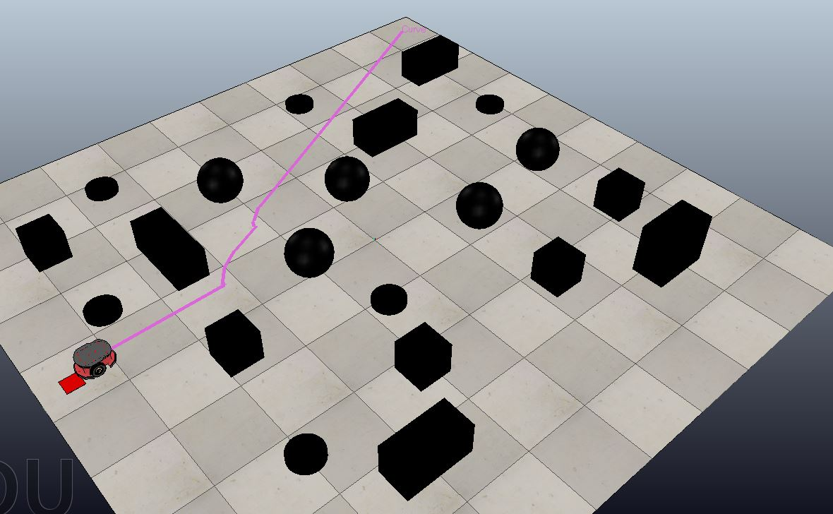
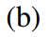
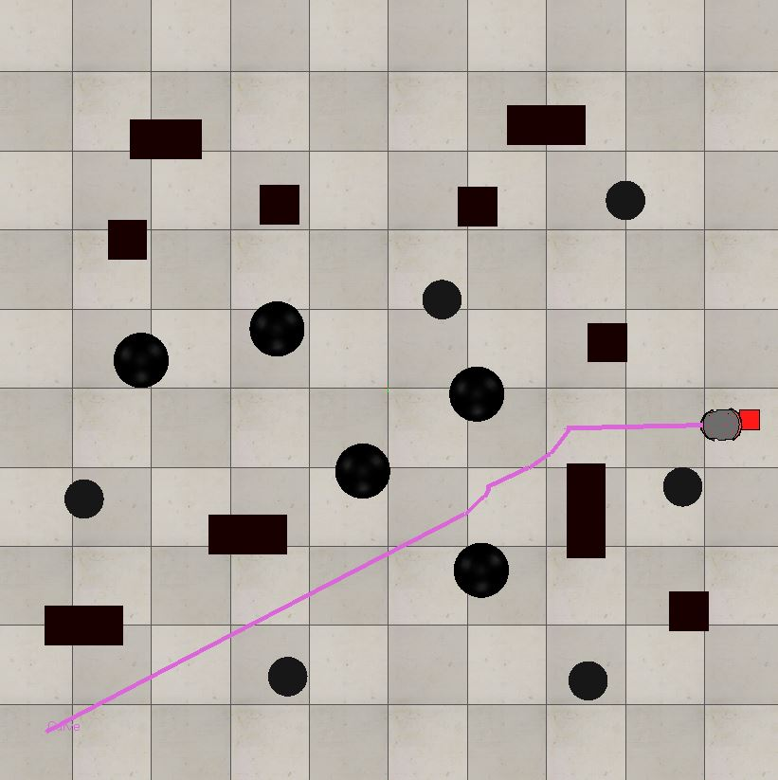
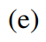
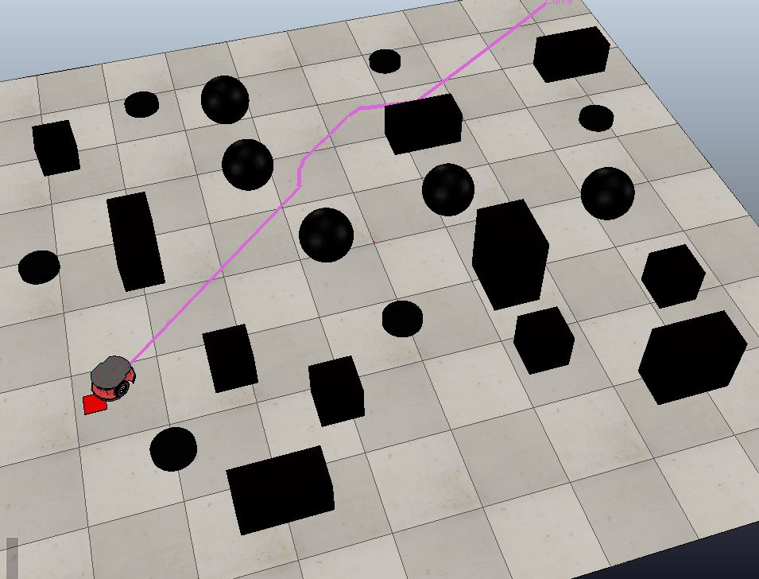
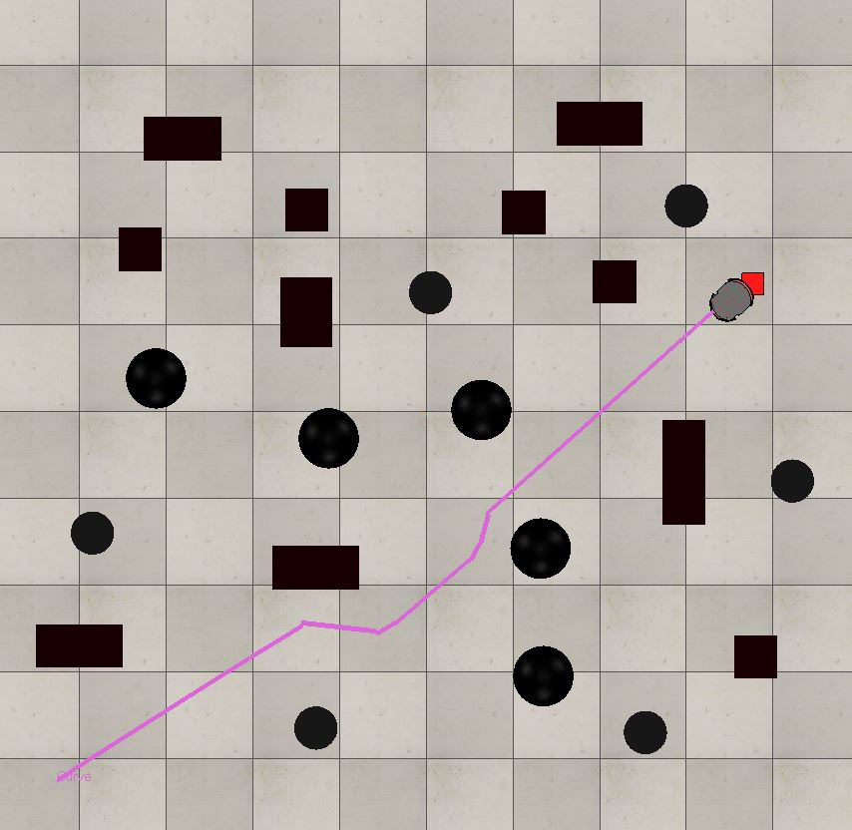
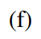

Fig. 7-(b,c) and
Fig. 7-(e,f) represents top view and 3D view respectively
Robust
The proposed method is computationally less expensive so it produces a robust solution
Obstacle Avoidance
Robot successfully avoids all the obstacle coming in its way under proposed ANFIS controller
Target Navigation
Proposed ANFIS controller effectively guides the mobile robot to navigate toward the target
Results and Discussions
Similarly, to test the repeatability in performance and autonomous
navigation behavior without collision the robot is tested in different cluttered environment. The results of simulation studies show that the proposed ANFIS controller efficaciously achieves the proposed behaviors.
Different obstacle prone cluttered environments

Slide 12
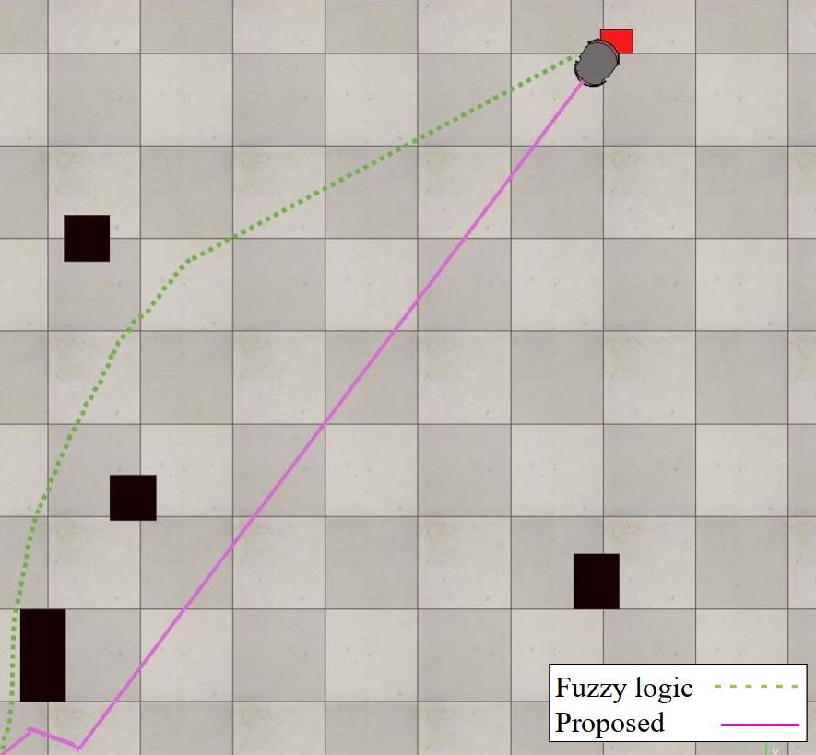
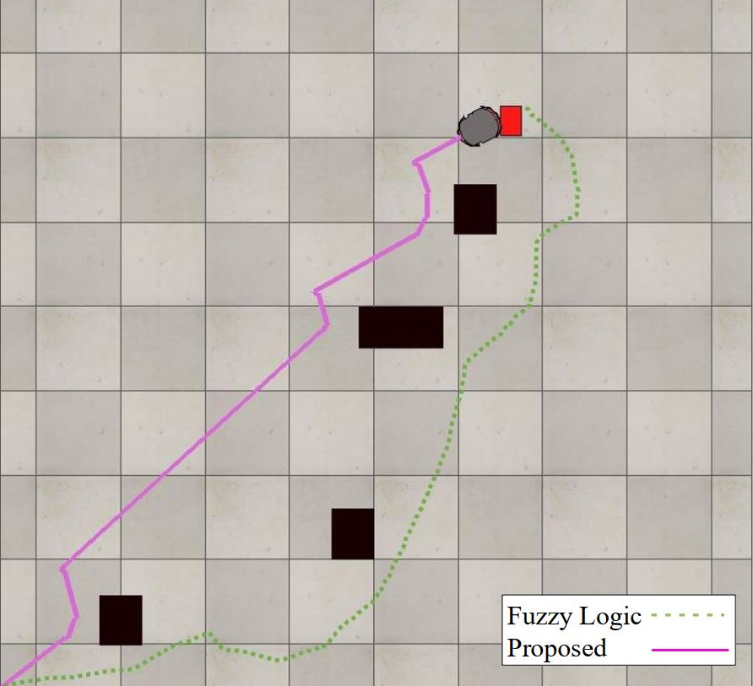
Results and Discussions
Fuzzy logic-based controller by Omrane et al. [20]
Comparisons
Fig. 8-(a) illustrates a comparison between proposed ANFIS controller and fuzzy logic based controller [20]. A single fuzzy logic-based controller [20] is designed to navigate the robot from an initial position to the target. However, there exist challenges as two controller designs have been presented. Firstly, a fuzzy navigational controller is designed with 35 rules, but it can only perform the target navigation task. Secondly, an improved controller design with 62 rules is also discussed. Nevertheless, it can only navigate in very simple environments with a few obstacles, as presented in Fig. 8-(a). It is worth noting that increasing the number of rules adds up more parameters to be evaluated and optimized that drastically heightens the complexity of the controller. Fig. 8-(b) represents another environment of the fuzzy navigational controller which is comparatively difficult than Fig. 8-(a) as there are multiple obstacles in the sight of the target. In both scenarios, fuzzy logic navigational controller [20] produce a very long path. The proposed ANFIS controller is designed with 16 rules that follow the optimal path to reach the target, keeping it in view that the obstacles and map are unknown to the robot.

Slide 13
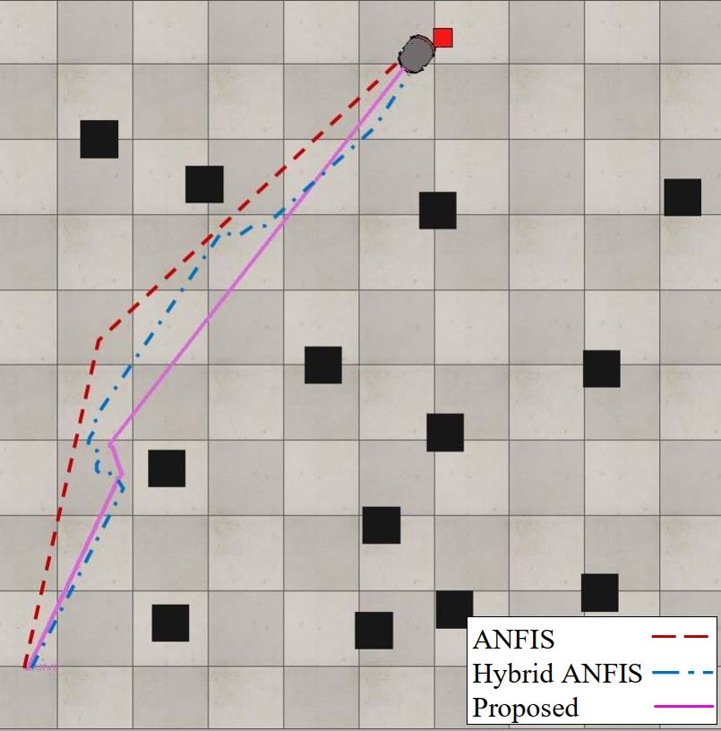
Results and Discussions
Comparisons
Comparison among hybrid ANFIS [14], ANFIS controller [21] and proposed method is shown in Fig.8-(c). From Fig. 8-(c), it is evident that the proposed controller moves straight with fewer turns, hence providing an optimal path comparatively.
In diverse environments, where the task of motion planning is particularly arduous by the presence of a variety of various shaped and sized barriers, the ANFIS controller guides the robot through a variety of obstacles, allowing it to determine efficient paths to the target. By navigating under unknown surroundings, achieving efficient performance in cluttered, complex environments, and generating near-optimal solutions, the ANFIS controller tackles the inadequacies of the proposed previous methods. To prove the efficacy various simulations studies have been presented in Fig. 7 and Fig. 8. The predominance of the proposed ANFIS controller is observed through the simulations results.
Hybrid ANFIS [14],
ANFIS controller [21]

Slide 14


Conclusion
Trajectory Planning
Better Performance
This paper proposes a method to optimally plan a trajectory while avoiding all the obstacles. Moreover, the proposed method is computationally less expensive as it introduces 16 rules compared to hundreds of rules proposed by previous methods
We conducted comprehensive experiments in order to validate the supremacy of the proposed method. The results of the experiments support the performance claims.
Obstacle Avoidance
A single ANFIS controller is proposed to simultaneously ply the mobile robot’s obstacle avoidance and target navigation

Slide 15

Q/A Session

Slide 16
References
All the figure, equations, results and references are taken from the “D-034: Autonomous Mobile Robot Navigation using Adaptive Neuro Fuzzy Inference System”

